Slide 1

Dhanekula Institute of Engineering and Technology
FAKE SOCIAL MEDIA PROFILE DETECTION USING ENSEMBLE LEARNING
Ganguru, Vijayawada (520013)
Project Review
presented by BATCH NO.13
M. Sowmya Devi (218T1A4228)
B. Pranab Karthik (228T5A4203)
Y. Sandhya (218T1A4253)
R. Sai Vamsi Krishna (218T1A4256)
Under the Guidance of:
Dr. M. Vinod Kumar
(Associate Professor)

Slide 2
ABSTRACT
ABSTRACT
Online Social Networking platforms have become an integral part of daily life, but they also attract malicious bots that mimic human behavior and pose significant cybersecurity threats. This literature review explores recent Machine Learning-based techniques for detecting and classifying bots on major social media platforms, covering supervised, semi-supervised, and unsupervised approaches. It examines dataset details, feature categories, and the evolving challenges posed by increasingly sophisticated bots designed to evade detection. Additionally, the study highlights concerns regarding data privacy and the influence of unverified and malicious content on user perceptions. A taxonomy for classifying malicious information at various stages is presented, along with technologies to combat misinformation from content generation to containment. The findings demonstrate the effectiveness of Machine Learning in enhancing the security and reliability of social media platforms, providing a scalable solution to mitigate online deception

Slide 3

INTRODUCTION
Fake social media profiles have become a serious concern in today’s digital world, often used for spreading misinformation, committing fraud, and stealing identities. Traditional detection methods like manual reviews and rule-based filters are slow and ineffective against the increasing sophistication of fake accounts. This project introduces a machine learning-based solution using ensemble models such as Random Forest, XGBoost, and SVM to automatically detect and classify fake profiles with high accuracy. By analyzing user behavior, profile details, and engagement patterns, the system ensures real-time detection and helps enhance the safety and reliability of social media platforms.

Slide 4
MOTIVATION
Cyber threats and fake accounts ae growing rapidly on social media.
Fake profiles are used in financial scams, identity theft, and misinformation.
There’s a need for automated solutions due to the scale of the problem.
ML can analyze complex data patterns and identify suspicious behavior.

Slide 5
PROBLEM STATEMENT
The rapid growth of social media platforms has led to an increase in fake profiles that impersonate real users, spread misinformation, and engage in fraudulent activities. These fake accounts pose significant threats to cybersecurity, privacy, and online trust, making their detection and mitigation a crucial challenge. Traditional rule-based detection methods struggle to keep up with the evolving tactics used by malicious actors to evade identification.
This project aims to develop a Machine Learning-based approach for identifying and reporting fake social media profiles by analyzing various features such as user activity, content patterns, network behavior, and metadata. By leveraging supervised, semi-supervised, and unsupervised learning techniques, the system will enhance accuracy, efficiency, and scalability in detecting fake accounts. The study also addresses challenges related to data privacy, adversarial evasion techniques, and real-time detection, ensuring a robust and adaptable solution to improve social media security
.

Slide 6

CHALLENGES
High Volume of Fake Profiles
Thousands of fake accounts are created daily, making manual detection impractical.
Evolving Fraud Techniques
Fraudsters use advanced methods like AI-generated images, deepfakes, and bots to mimic real profiles.
Data Privacy and Security
Ensuring user data is analyzed without violating privacy laws (e.g., GDPR) is a major concern.
False Positives and False Negatives
Real accounts may be wrongly flagged as fake, and some fake profiles might go undetected.
Scalability of the System
The model must be capable of processing large amounts of data in real time without performance issues.

Slide 7
LITERATURE SURVEY
Several researchers have explored fake profile detection using machine learning techniques. Joshi et al. (2021) proposed a hybrid model combining Decision Trees and Support Vector Machines (SVM), leveraging both interpretability and classification strength. Their study emphasized profile attributes and behavioral features for detection. Shehzad et al. (2022) focused on ensemble techniques like Random Forest, Gradient Boosting, and Voting Classifiers to enhance detection on large-scale social media datasets. They highlighted the need to analyze interaction diversity, post frequency, and sentiment. Bhattacharya et al. (2021) extracted features such as friend count, language patterns, and profile activity, using Random Forest, AdaBoost, and XGBoost to increase reliability. Romanov et al. (2021) categorized detection into two types: individual profile analysis and coordinated fake activities (botnets), using ensemble methods and social network metrics. Meanwhile, Singh et al. (2022) integrated deep learning models like CNNs and RNNs in an ensemble setup to capture complex behavior and textual inconsistencies in fake profiles. These studies show that ensemble learning significantly improves classification performance. However, many of them lacked real-time deployment capabilities, which this project addresses through Flask-based integration, enabling real-time detection and reporting of fake profiles.

Slide 8
Proposed Solution Overview
The proposed solution aims to detect fake social media profiles using ensemble learning techniques, which combine the strengths of multiple machine learning models to improve classification accuracy and reliability. This system integrates algorithms such as Random Forest, XGBoost, Support Vector Machine (SVM), and Logistic Regression to analyze user data and identify suspicious patterns. The workflow begins with data collection from social media platforms using APIs and web scraping tools, followed by data preprocessing to clean and normalize the data. Next, feature extraction is performed, focusing on both profile-based features (e.g., account age, profile completeness) and activity-based features (e.g., posting frequency, sentiment). These features are used to train the ensemble models, which are evaluated using metrics like accuracy, precision, recall, and F1-score. The best-performing model is then deployed using the Flask framework, enabling real-time detection through a user-friendly web interface. The system is also scalable and can be continuously updated with new data to adapt to evolving fake profile behaviors, ensuring high performance and effective detection in real-world scenarios.

Slide 9

SYSTEM ARCHITECTURE
Flow of the system:
Data Collection
Preprocessing
Feature Engineering
Model Training
Real-Time
Detection

Slide 10

DATA COLLECTION
Dataset Type: Twitter profile datasets
Number of Datasets: Two (fusers and users)
Rows per Dataset: 6,825
Columns per Dataset: 38
Content: User profile information
Purpose: Used for fake profile detection

Slide 11
DATA PREPROCESSING
1.Data Cleaning: Remove duplicate records.
2. Handling Missing Data:Remove rows/columns with too many missing values.
3. Feature Selection & Engineering:Convert categorical variables into numerical representations (One-Hot Encoding or Label Encoding)
4. Data Transformation & Scaling: Normalize numerical data using Standard Scaler and Convert boolean values to numeric (0/1).
5. Encoding Categorical Variables:Convert textual data into numerical format using Label Encoding or One-Hot Encoding.
6. Splitting the Dataset:Split data into training and testing sets (e.g., 80% train, 20% test).

Slide 12
ENSEMBLE LEARNING
Combines predictions from multiple models for better performance.
Stacking: Layers models to refine results.
Boosting: Focuses on correcting previous errors.
Results in better accuracy, stability, and generalization.

Slide 13

MODEL TRAINING
Logistic Regression (LG) – A statistical model that predicts probabilities and is widely used for binary classification problems.
Naïve Bayes (NB) – A probabilistic classifier based on Bayes’ theorem, suitable for text-based and categorical data.
Support Vector Machine (SVM) – A powerful classifier that finds the optimal hyperplane to separate data points.
Decision Tree (DT) – A tree-structured model that splits data into branches based on feature conditions.
Random Forest (RF) – An ensemble of multiple decision trees to improve accuracy and reduce overfitting.
XGBoost (XGB) – A gradient boosting model known for high efficiency and performance in classification tasks.

Slide 14
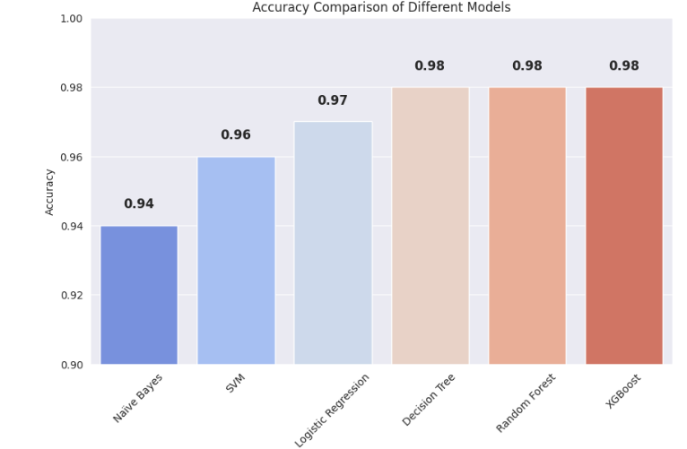
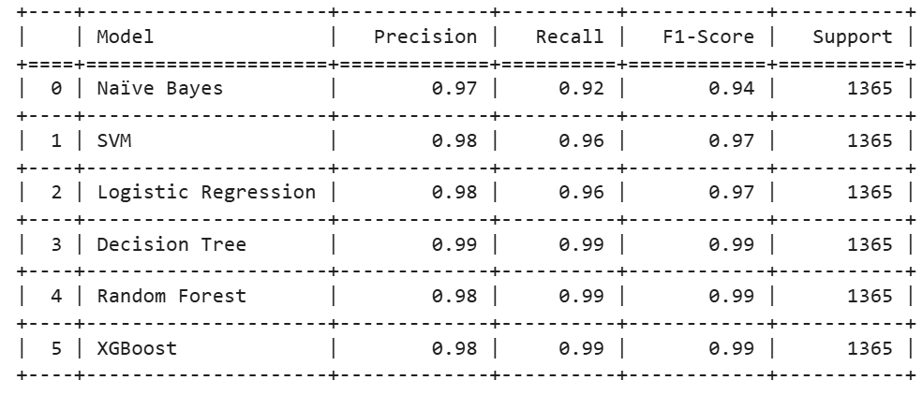
MODEL EVALUATION
The trained machine learning models were tested using metrics like accuracy, precision, recall, and F1-score. These metrics help measure how well the models can identify fake profiles. Among all models, XG Boost performed the best, achieving an accuracy of around 98.2% and precision of 99%. Techniques like cross-validation and Grid Search CV were used to improve the model’s performance and avoid overfitting. This ensured the system is reliable and accurate for real-time fake profile detection.

Slide 15
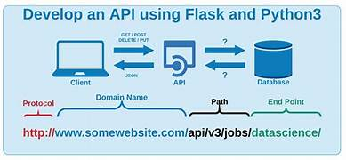
MODEL DEPLOYMENT USING FLASK
Step 1.Flask Web App for User Predictions – A Flask-based web interface allows users to input profile data for prediction.
Step 2. XG Boost Model for Fake/Real Prediction: The trained XG Boost model processes input features to classify profiles as fake or real.
Displaying Results – The prediction outcome is displayed on the web browser for the user.

Slide 16
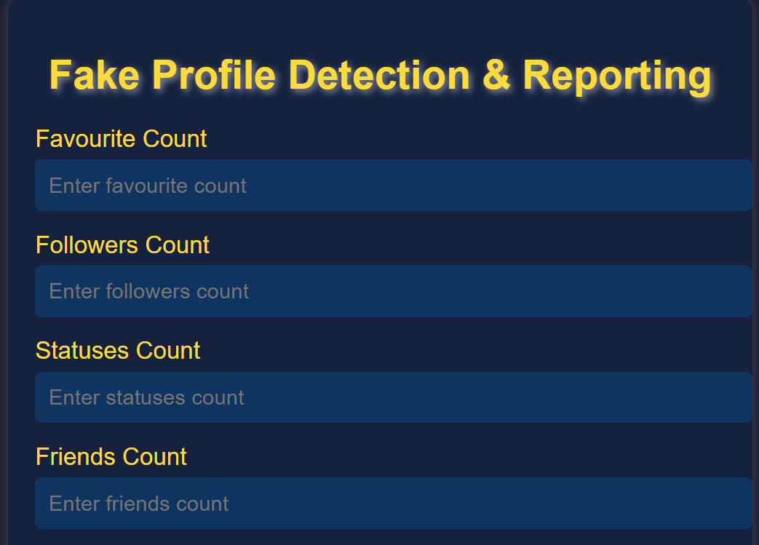
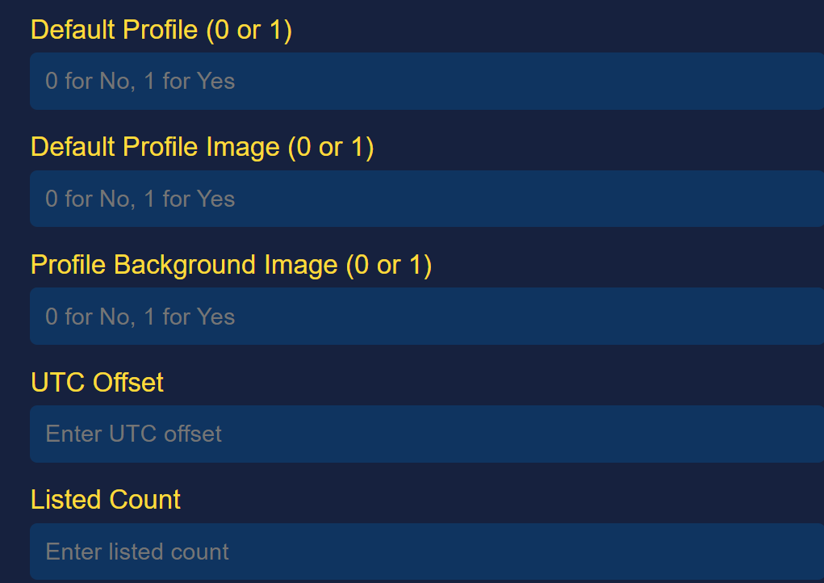
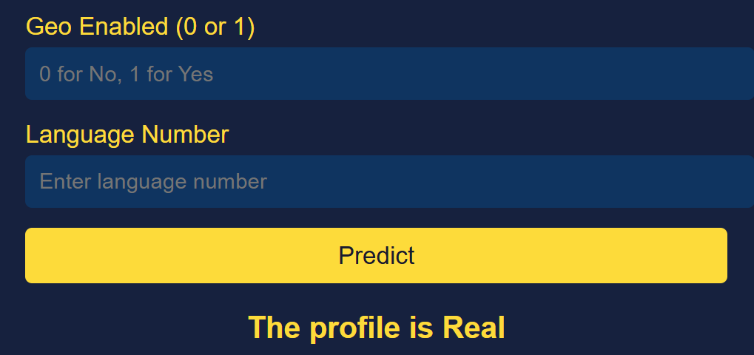
RESULTS

Slide 17

CONCLUSION
This project successfully detects fake profiles using machine learning, with XGBoost providing high accuracy. The system analyzes user profile features and is deployed using Flask for real-time predictions. It enhances online security by identifying fraudulent accounts, helping maintain genuine user interactions. Future work can explore larger datasets and advanced techniques for improved detection

Slide 18
FUTURE SCOPE
1.Enhancing Model Performance
2. Real-time Detection
3. Feature Expansion
4. Scalability
5. Automation & Adaptability

Slide 19
REFERENCES
Joshi, P. et al. (2021) – "Hybrid Machine Learning Approach for Fake Profile Detection on Social Media," International Journal of Computer Applications.
Shehzad, B. et al. (2022) – "Detecting Fake Profiles Using Ensemble Machine Learning Techniques on Large-Scale Data," Journal of Big Data Analytics.
Bhattacharya, S. et al. (2021) – "Improving Fake Profile Classification Using Feature Engineering and Ensemble Models," IEEE Access.
Romanov, A. et al. (2021) – "A Review on Ensemble Learning Approaches for Fake Social Media Profile Detection," ACM Computing Surveys.
Singh, R. et al. (2022) – "Deep Ensemble Learning Framework for Detecting Fake Profiles on Twitter," International Journal of Information Technology.
Purba, J. et al. (2020) – "Instagram Fake Follower Detection Using Ensemble Classification Models," Elsevier Procedia Computer Science.

Slide 20


